Slide 1
LLM FINETUNING
Konstantin Preußer

Slide 3
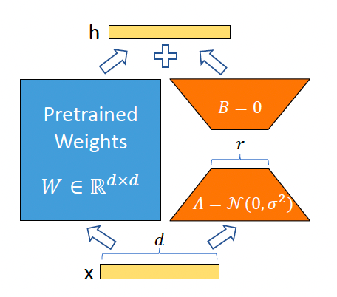
Fine Tuning
Retrain / Improve Model Weigths
QLoRa / LoRa

Slide 4
PEFT
Python library

Slide 5
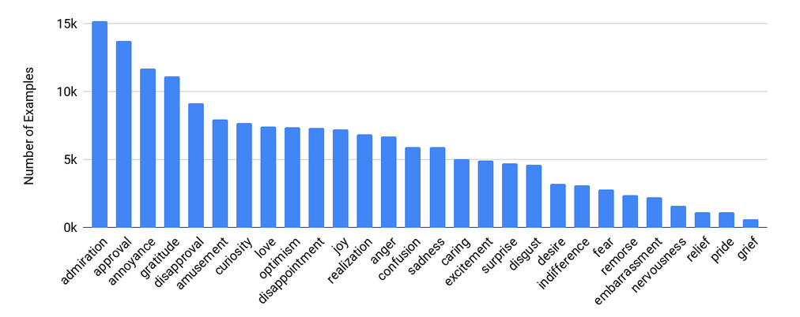
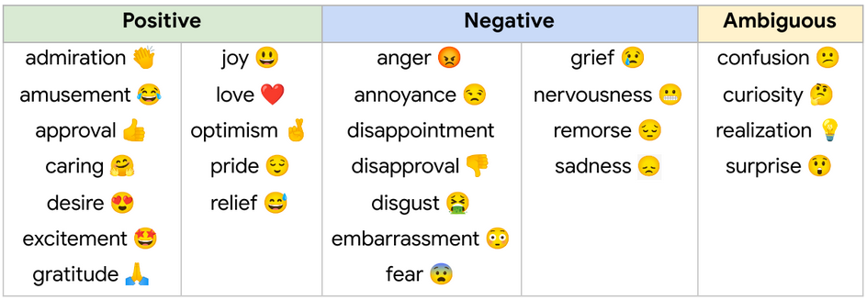
GoEmotion
Google dataset
27 (+1) emotions
Text to int

Slide 6
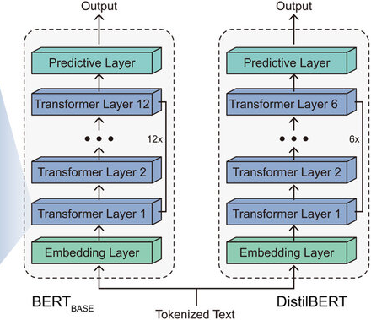
Models
Model < Memory / 12
-> 24GB Memory -> Model less than 2GB

Slide 7
Code

Slide 8
Code

Slide 9
Code

Slide 10
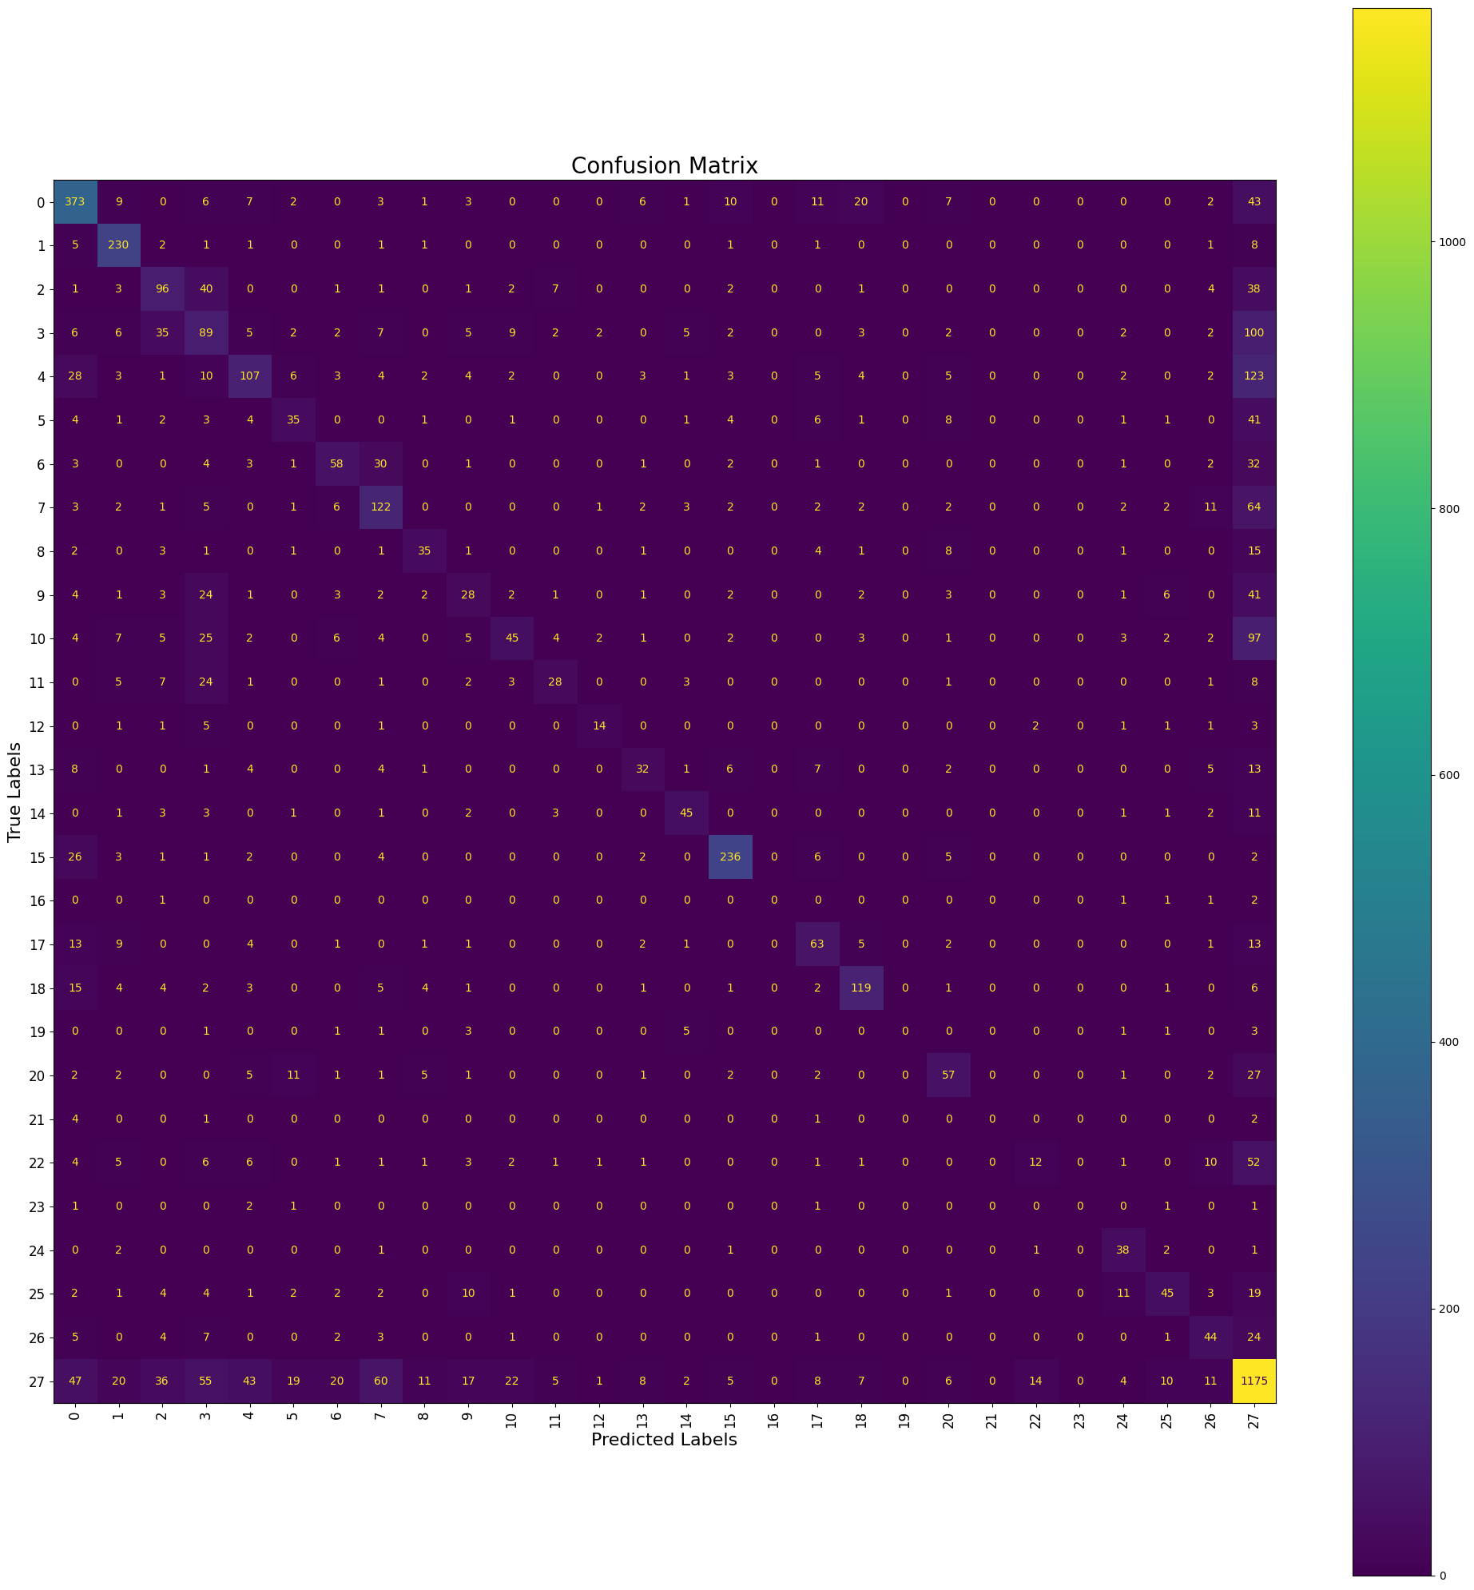
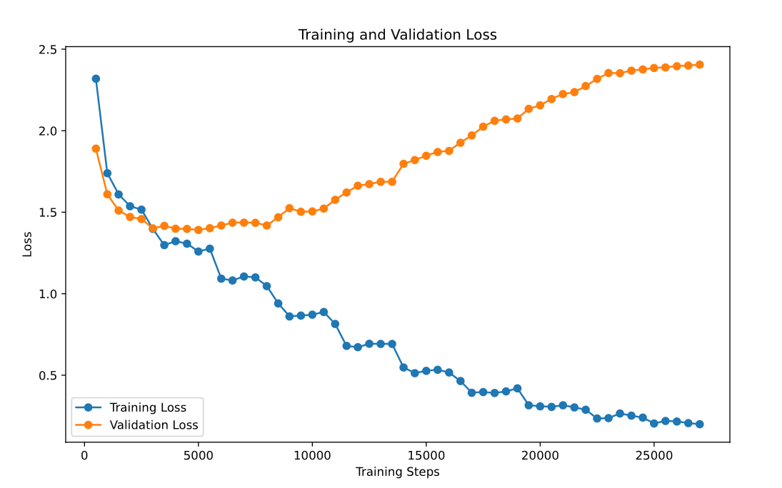
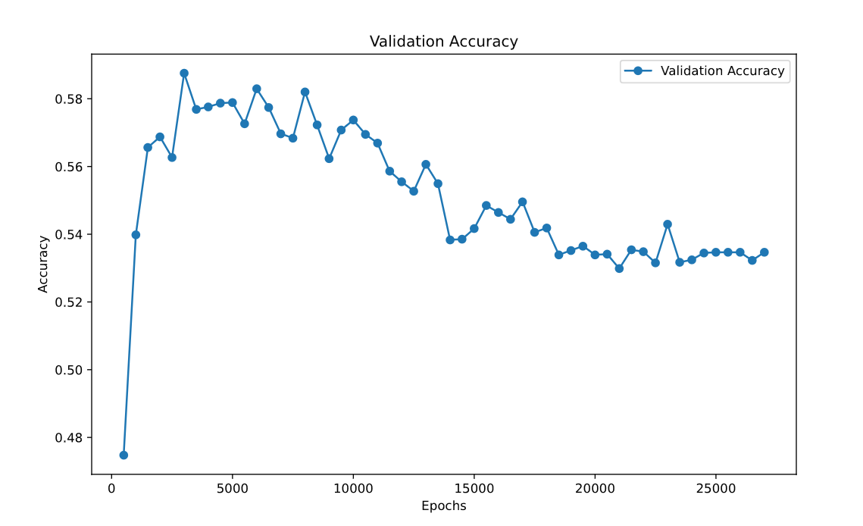
Results Distillbert
Annoyance / Acceptance
- Yep, you can go around crashing into things and run people over and completely get away with it.
Batch 16
Finetuning last 2 Layers
Test accuracy = 58%

Slide 11
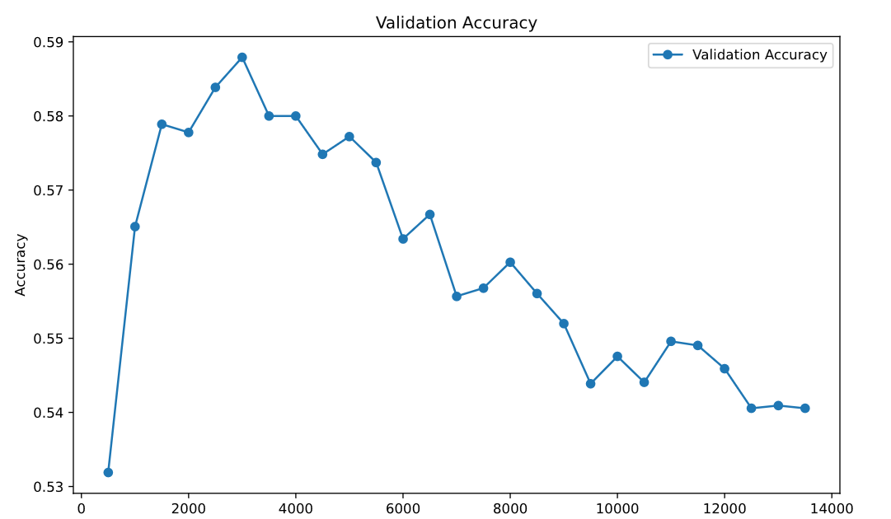
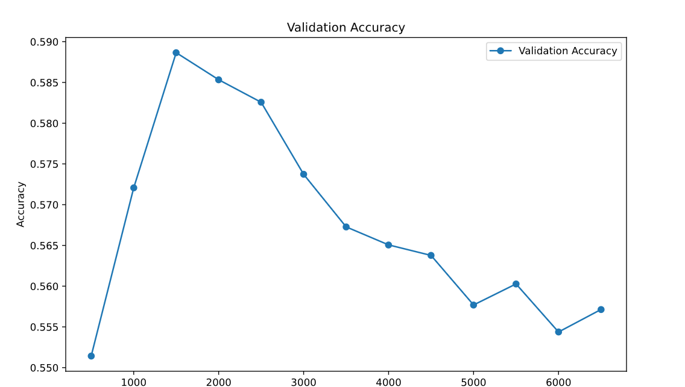
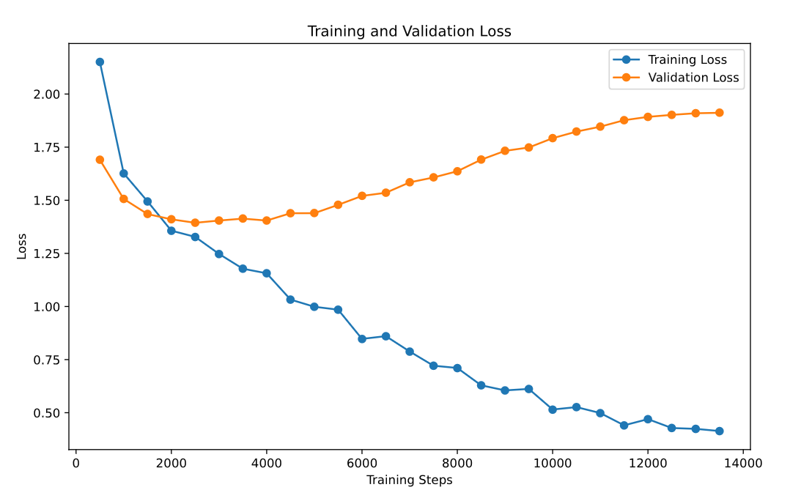
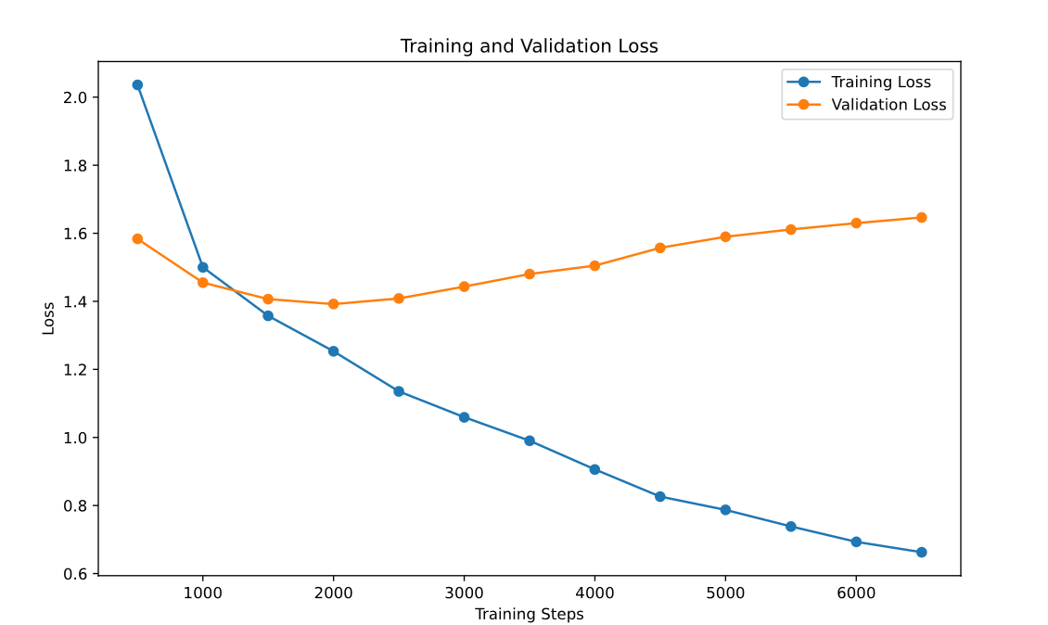
Results Distillbert
Batch of 32
Batch of 64

Slide 12
Results Distillbert with LoRa
Batch 64

Slide 13
DB Pedia
14 Categories

Slide 14
Results

Slide 15
Limitations
Need for big computing power
Large amounts of new data needed
Modules are not very harmonic

Slide 16
Conclusion
Impressive results for complex text classification tasks
LLM‘s can be fine tuned to do a lot of different tasks
Domain changes rapidly -> old projects don’t work anymore
Projects scale based on compute/money

